Slide 1
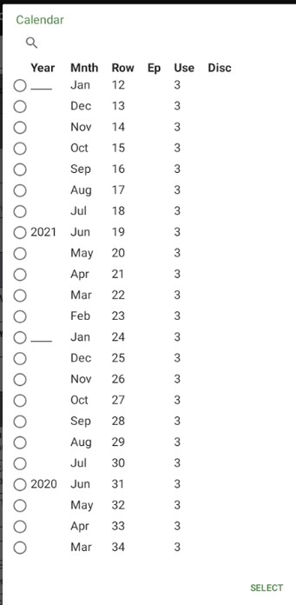
Woman’s Questionnaire: completing the calendar in CAPI

Slide 2
Calendar
Much of calendar is filled automatically by the CAPI system, namely:
Births, pregnancy losses, terminations
Current contraceptive method and date started using current method
CAPI system uses a series of probing questions to “fill in the gaps” between events recorded automatically, known as “History of events”
Notes:
At DHS we define a CAPI operation as a

Slide 3
Please note:
To aid understanding, the following slides use screenshots from the CSPro Windows interface to illustrate the working of the calendar
Android system has exactly the same logic but is limited to one/few questions per screen
Notes:
At DHS we define a CAPI operation as a

Slide 4
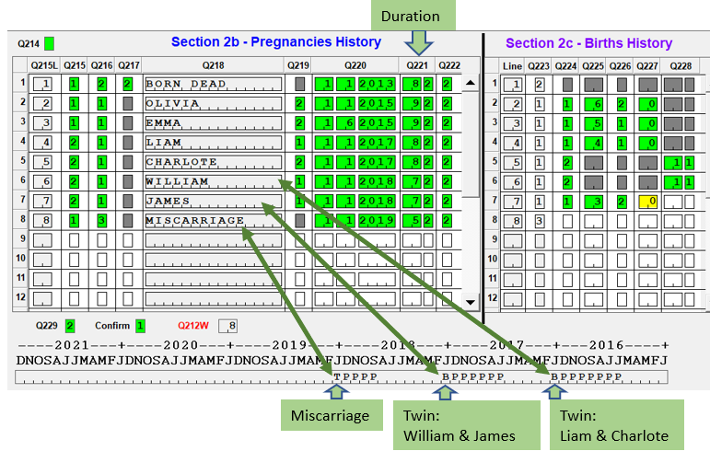
Pregnancy history and the Calendar
CAPI system automatically records pregnancies based on information given in pregnancy history
Type of pregnancy
Duration
Date of end of pregnancy
Notes:
At DHS we define a CAPI operation as a

Slide 5
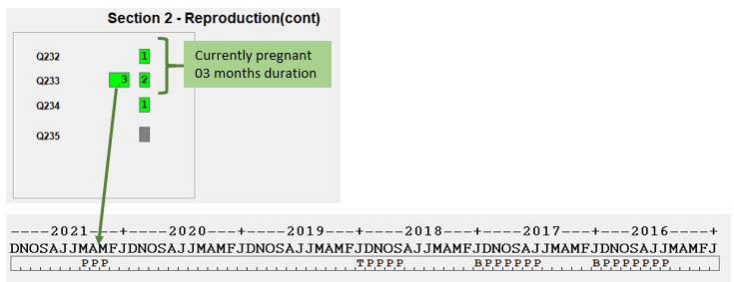
Current pregnancy
CAPI system records information about current pregnancy based on earlier questions
Whether currently pregnant
Duration of pregnancy
Notes:
At DHS we define a CAPI operation as a

Slide 6
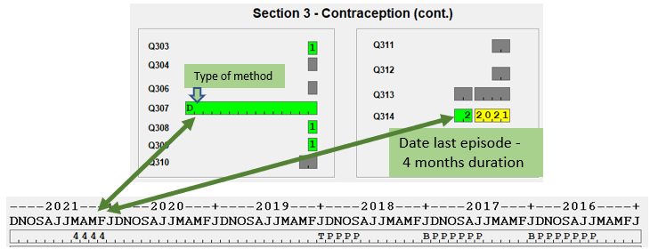
Current contraceptive use and the Calendar
CAPI system records information about current contraceptive use from questions entered
The type of method
Date began using
Notes:
At DHS we define a CAPI operation as a

Slide 7
History of use of methods / Episodes of contraceptive use
Series of questions used to “fill in the gaps” in the calendar
For each episode
Did respondent use a method in that time period?
If so, when did they start to use the method?
For how long did they use the method ?
What was the reason why they stopped using the method ?
Notes:
At DHS we define a CAPI operation as a

Slide 8
History of use of methods / Episodes of contraceptive use
Read the Interviewer manual pages 61-65 on the Episodes of contraceptive use
Display and discuss the manual pages on the projector as they are being read
Notes:
At DHS we define a CAPI operation as a

Slide 9
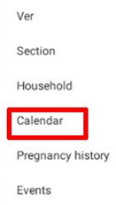
Displaying a visual representation of the calendar in the CAPI system
Click on the CAPI toolbar and select “Calendar”
Will display calendar as it is shown in the paper questionnaire
Information shown is based on your position in the questionnaire
Need to scroll down to see all months
It is very helpful to use this feature to see current status of the calendar
Notes:
At DHS we define a CAPI operation as a

Slide 10
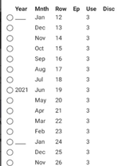
Calendar table
Title | Description
Year | Year of row
Mnth | Month of row
Row | Number of row in calendar
Ep | Indicates the current gap or episode being asked about, if the calendar option is used when entering the History of use of methods section
Use | Use of method or event
Disc | Code for discontinuation (if used)
Notes:
At DHS we define a CAPI operation as a

Slide 11
Calendar Exercises
Will continue with mock interview and complete calendar section
Will have additional exercise using Jane Doe example
Notes:
At DHS we define a CAPI operation as a

Slide 12
THANK YOU
Questions or Comments?

